Slide 1
DSC530 – Final Project
Dan Wiltse
05/30/2020

Slide 2
Statistical question
What factors contribute to college football teams winning more than others?

Slide 3
Variables Used
Variable | Description
Wins | Total wins during the 2019 college football season
PF | Points scored by the team during the season
PA | Points scored by opposing team during the season
Five_year_avg_recruit_rank | Average recruiting class rank across previous five recruiting classes (2015-2019)
OffensesuccessRate | efficiency metric that determines the success of a play. Successful plays meet one of the following criteria: the offense scored 1st downs which gain at least 50% of the yards to go 2nd downs which gain at least 70% of the yards to go 3rd and 4th downs which gain at least 100% of the yards to go
DefensesuccessRate | Same criteria for offense success rate above, only for team’s defense
Defensehavoctotal | percentage of plays in with the defense recorded a TFL, forced a fumble, intercepted a pass or broke up a pass

Slide 4
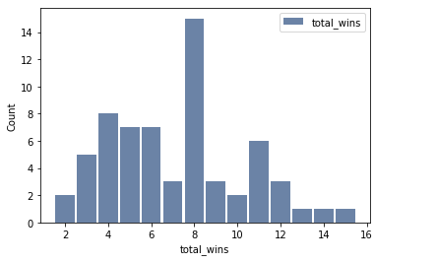
Histogram
Most common win total is 8

Slide 5
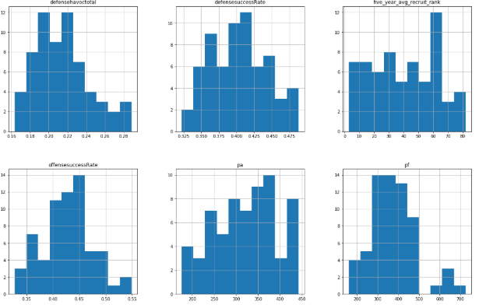
Histograms

Slide 6
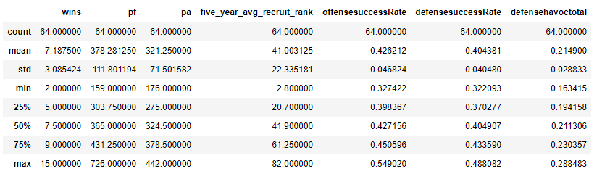
Descriptive Statistics

Slide 7
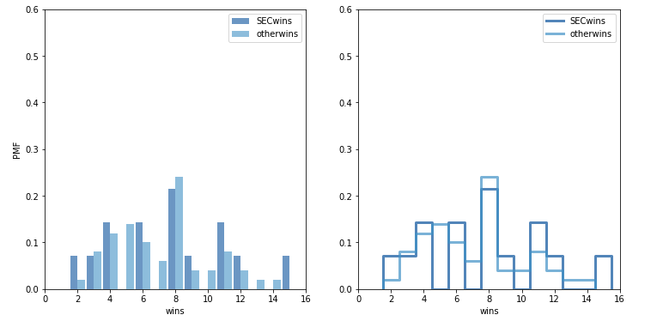
PMF – SEC wins vs all other conferences
Comments here

Slide 8
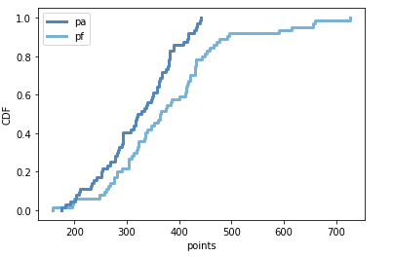
CDF
Comparison of
Points For and Points
Against

Slide 9
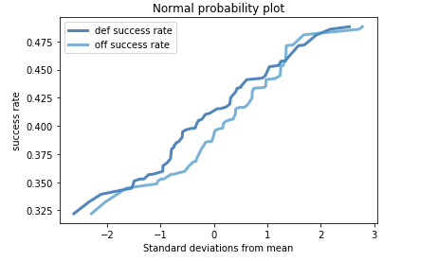
Analytical Distribution
Normal Probability Plot

Slide 10
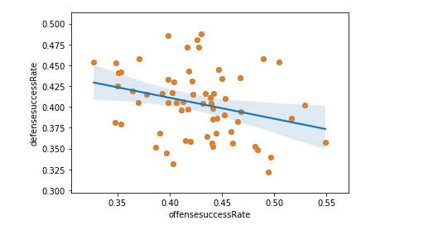
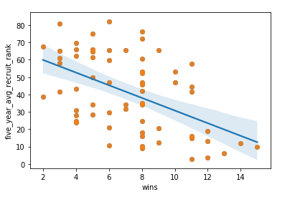
Correlations
Wins by Recruiting Ranking Offense vs Defense Success Rate
Better recruiting ranking related to more wins Appears to be slight relationship between offense and defense success rate

Slide 11
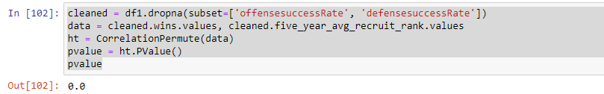
Conduct a test on your hypothesis using one of the methods covered in Chapter 9.
Correlation can be small but still be statistically significant
Doesn’t mean relationship is significant, just means that it’s unlikely that the effect occured by chance

Slide 12
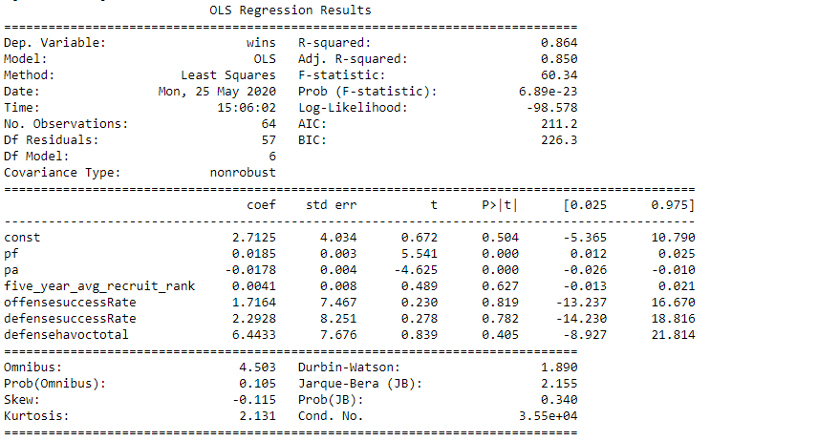
Conduct a regression analysis on either one dependent and one explanatory variable, or multiple explanatory variables (Chapter 10 & 11).
All metrics (may switch to a different model)

